Slide 1
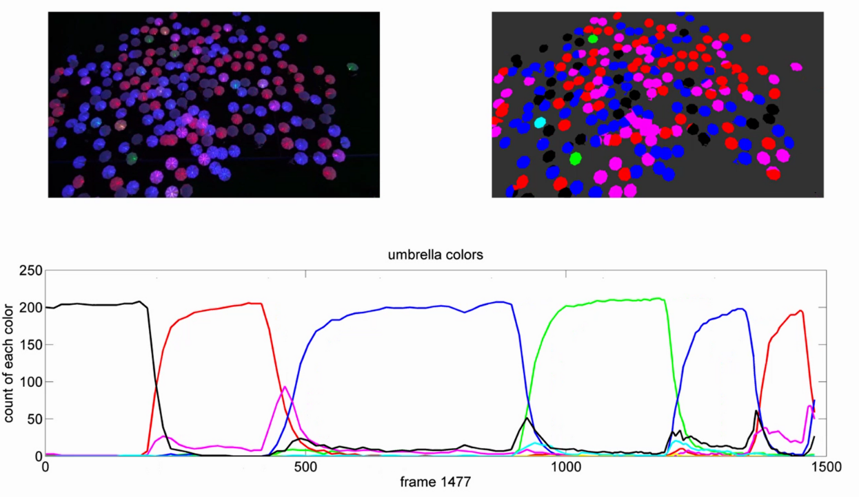
Fig1.
1. A capture of frame in the whole video, there are more than 200 umbrellas. Pick two umbrellas(A,B with red circles) to track their motion path, analyze their response
2. Umbrellas are moving follow the vocal commands, and change colors at same time
1
2
3
Umbrella Colors
Count of each color
Frame 1477

Slide 2
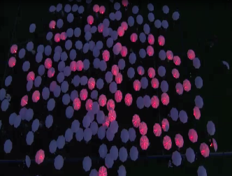
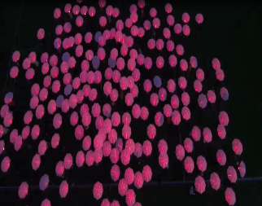
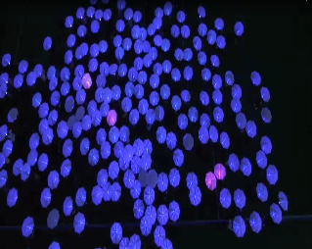
The time constant of the human swarm for a command "everyone turn red"
t=1
t=7
t=15
1
Fig. 2: Plot showing human response to vocal command “I want everybody to turn them red“. The command was announced at 6s. This was the first such command, and had a time constant of τ = XX. everyone turns to red
X轴时间与真实时间符合
Time constant 在所有颜色达到约95%时在图中标出
0.9
0.8
0.7
0.6
Accuracy
0.5
red1
0.4
blue1
green1
0.3
blue2
0.2
red2
blue3
0.1
green2
turn off
0
0
2
4
6
8
10
12
14
16
Time (s)

Slide 3
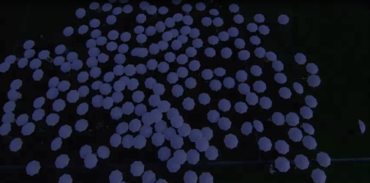
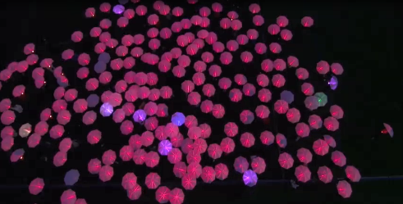
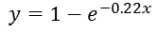
The time constant for the human swarm for a harder question "everyone turn to the same color"
t=83
t=93
1
Fig. 3. Response time for command “everyone turns to same color”, people start to move in the video around 82s, and till 94s, all people turn to same color,
0.9
0.8
0.7
0.6
Real ratio
Ratio of major color
$$y=1−e^{−0.22x}$$
0.5
0.4
0.3
0.2
0.1
0
82
84
86
88
90
92
94
Time (s)

Slide 4
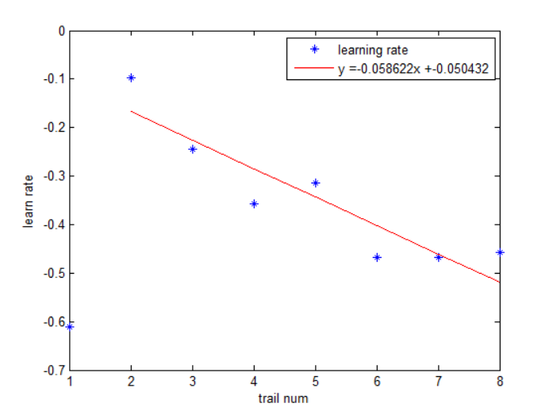
What is the learning rate of the human swarm? (that is, do they get faster at following commands?)
Fig.4 For a series of vocal command like “I want everybody to turn them red”, “turn the red off turn the blue on”, “let's go to green” actually people are learning all the time, their respond time is reducing every time when they hear the vocal command and make a response.
Axis([0,9,-0,7,00])
WHY IS THE LEARNING RATE NEGATIVE?
What’s the equation used to get learn rate

Slide 5
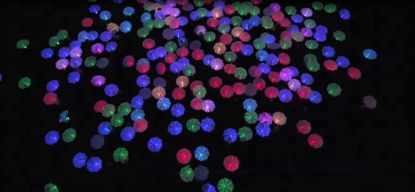
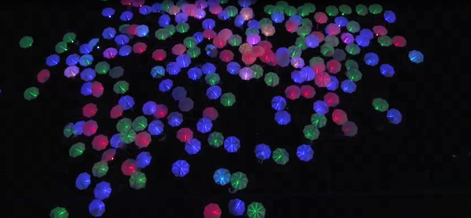
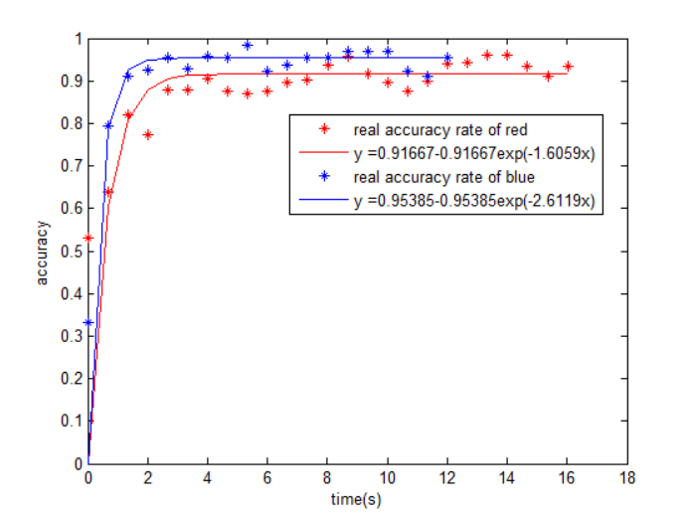
Comparing the accuracy
Fig.5 Comparing the accuracy of two vocal command “If you are red move.” and “When I say go I want red to freeze and the blues’ to move.”
Too many decimal places
Formula for accuracy
Show the whole process in same plot ( one accuracy after another)
Notes:
Too many decimal places
Formu;a for accuracy

Slide 6
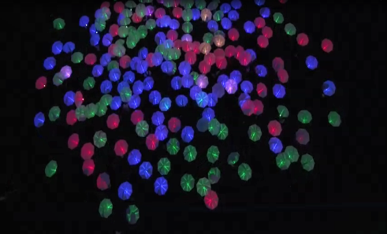
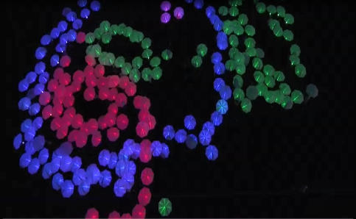
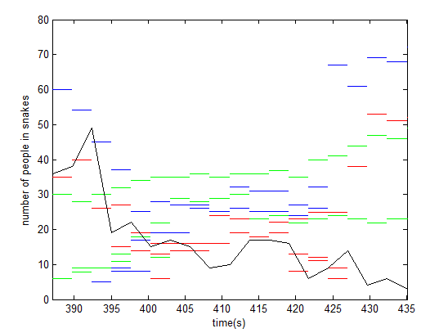
How long did it take to form snakes? How long were the snakes as a function of time?
This plot shows how long it takes to form snakes, x axis shows the time it takes, and y axis shows how long the snake is, which is how many umbrellas are there in the snake, and we have three different color snakes in the video
What constitutes a snake?
Add lane to same plot showing numbers of people who are not in the snake
t=385
t=435

Slide 7
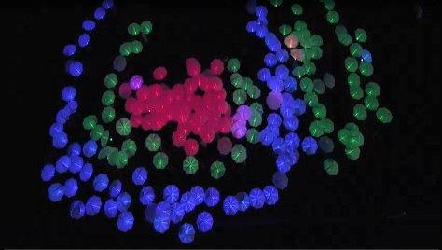
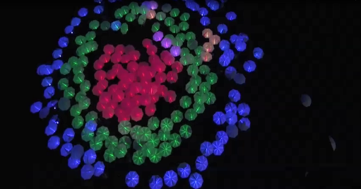
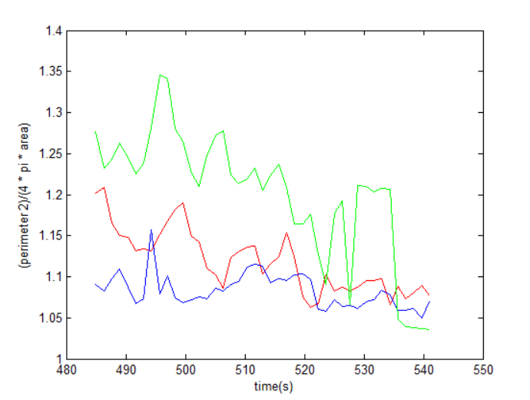
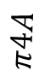
How round could they get?
t=485
t=540
Fig.6 We calculate how round those people can get after they hear the vocal command “Red stop and bunch up. See how round you can be, keep circling around them greens” There are three circles with different colors, the value closer to one means the circle is closer to a real round.
$$π4A$$

Slide 8
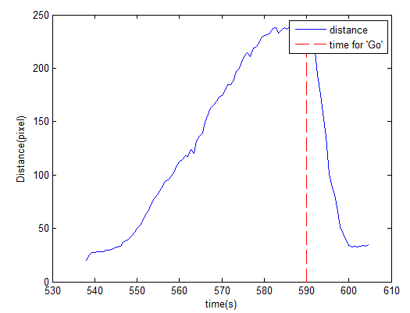
How good is their memory (what accuracy did they have when commanded to return to original positions?)
Fig.7 This figure shows how good people’s memory is, we comparing the distance between everyone’s “original position” and the “returned position”, and the smaller distance means better memory. when they heard the vocal command “when I say go I want you to move back, with the yellow right in the middle. Right back to where you were that same formation as quickly and safely as you can. As smoothly as you can.
” they will move back.
Should record the whole process, Start from original position, to some point, return (mark with a *), then go back to their position

Slide 9
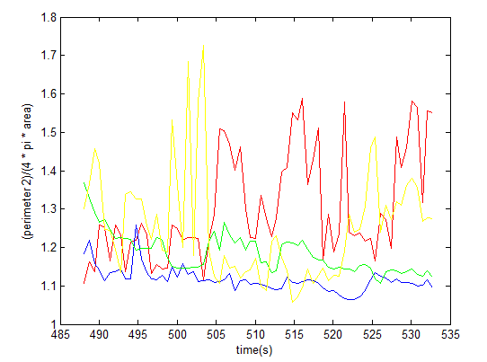
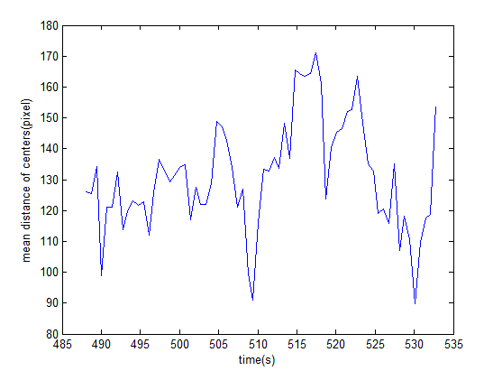
Calculate the mean distance between each center of three circles,

Slide 10
1
0.9
0.8
0.7
0.6
accuracy
0.5
red1
0.4
blue1
green1
0.3
blue2
0.2
red2
blue3
0.1
green2
turn off
0
0
2
4
6
8
10
12
14
16
Time (s)

Slide 11
t=1
t=7
t=15
1
0.9
0.8
0.7
0.6
Accuracy
0.5
red1
0.4
blue1
green1
0.3
blue2
0.2
red2
blue3
0.1
green2
turn off
0
0
2
4
6
8
10
12
14
16
Time (s)

Slide 12
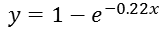
t=83
t=93
1
0.9
0.8
0.7
0.6
Real ratio
Ratio of major color
$$y=1−e^{−0.22x}$$
0.5
0.4
0.3
0.2
0.1
0
82
84
86
88
90
92
94
Time (s)

Slide 13
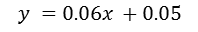
0.7
0.6
0.5
0.4
Learn rate
0.3
0.2
Learning rate
$$y =0.06x +0.05$$
0.1
0
1
2
3
4
5
6
7
8
Trail num

Slide 14
1
2
2.5
3
3.5
4
4.5
5
2
3
Time for accuracy to reaching 80%
4
Trail num
5
6
7
8

Slide 15
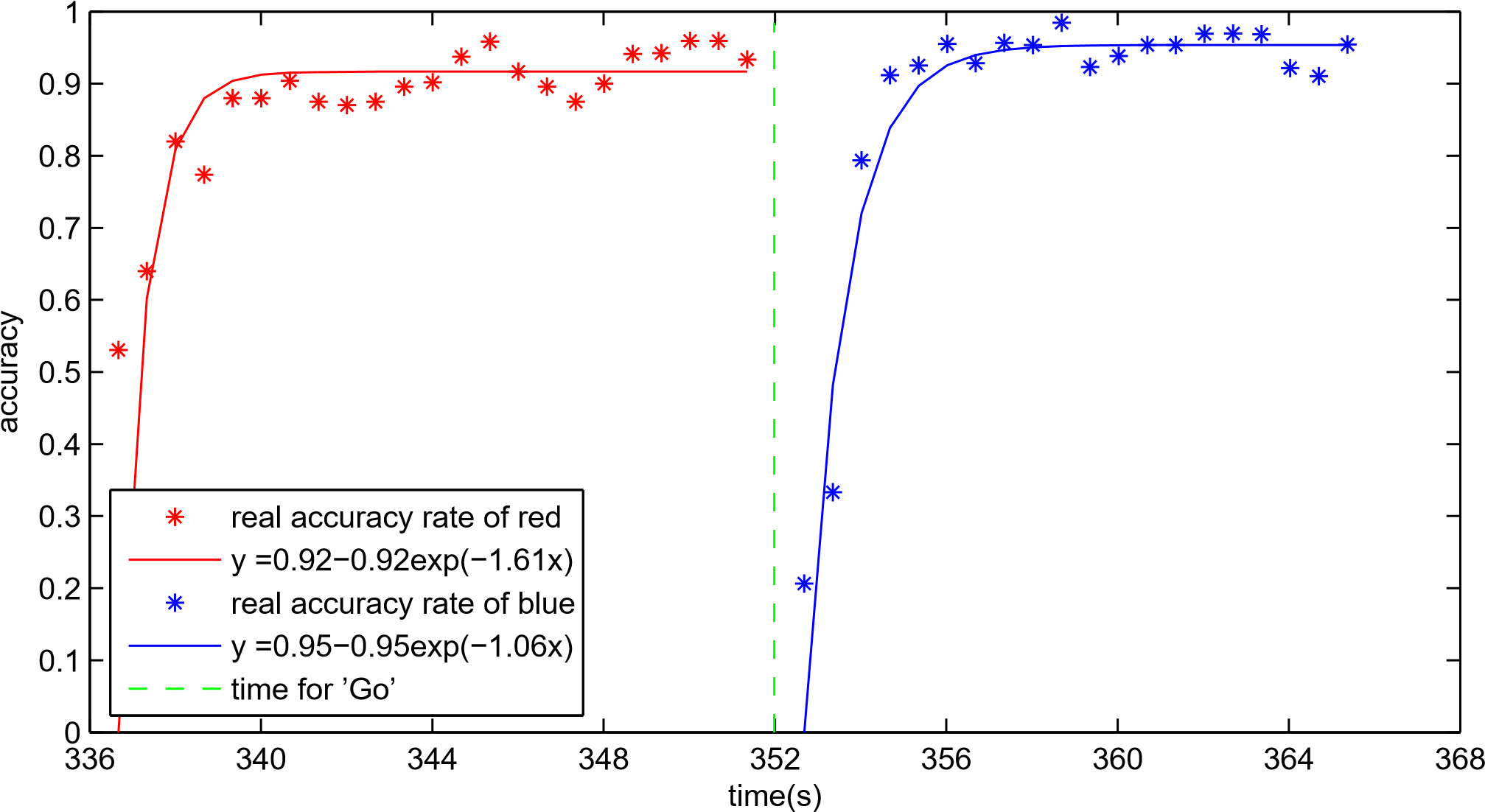
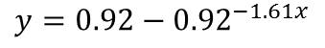
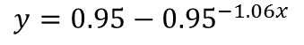
Accuracy
$$y=0.92−{0.92}^{−1.61x}$$
$$y=0.95−{0.95}^{−1.06x}$$
Time (s)

Slide 16
25
velocity of red
velocity of blue
time for ’Go’
20
Velocity (pixel/s)
15
10
5
0
335
340
345
350
355
360
365
370
Time (s)

Slide 17
25
velocity of red
velocity of blue
time for ’Go’
20
Velocity (pixel/s）
15
10
5
0
335
340
345
350
355
360
365
370
Time (s)

Slide 18

t=485
t=540
1.4
1.35
1.3
1.25
$$C^{2}/4πA$$
1.2
1.15
1.1
1.05
1
480
490
500
510
520
530
540
550
Time (s)

Slide 19
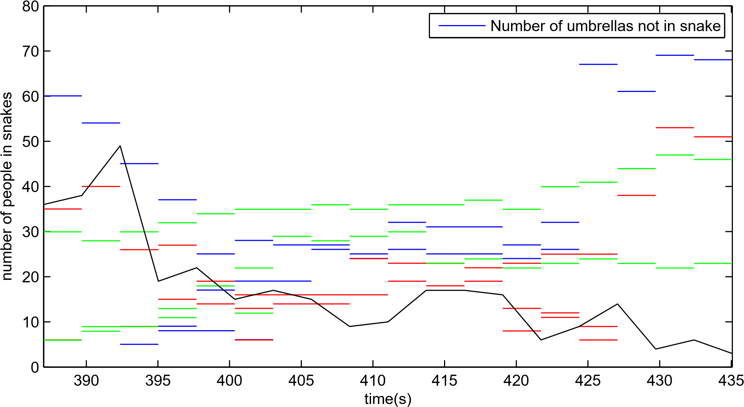
t=385
t=435
—— Number of people in snakes
Number of people in snakes
Time (s)

Slide 20
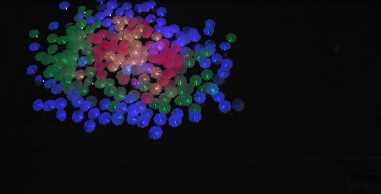
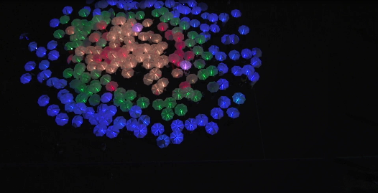

t=613
t=658
1.8
red umbrellas
1.7
blue umbrellas
green umbrellas
yellow umbrellas
1.6
1.5
$$C^{2}/4πA$$
1.4
1.3
1.2
1.1
1
610
615
620
625
630
635
640
645
650
655
660
Time (s)

Slide 21

t=613
t=658
300
Red
to blue
Red
to green
250
Blue
to green
200
Mean distance of centers (pixel)
150
100
50
0
610
615
620
625
630
635
640
645
650
655
660
Time (s)

Slide 22
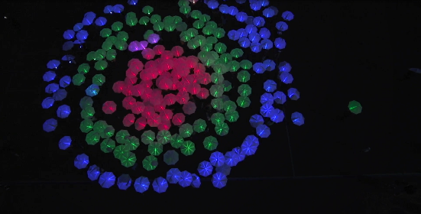
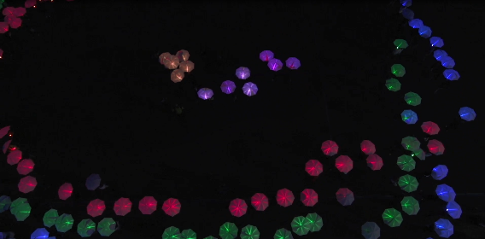

t=539
t=590
t=605
250
200
150
Distance (pixel)
100
distance
50
time for ’Go’
0
530
540
550
560
570
580
590
600
610
Time (s)

Slide 23
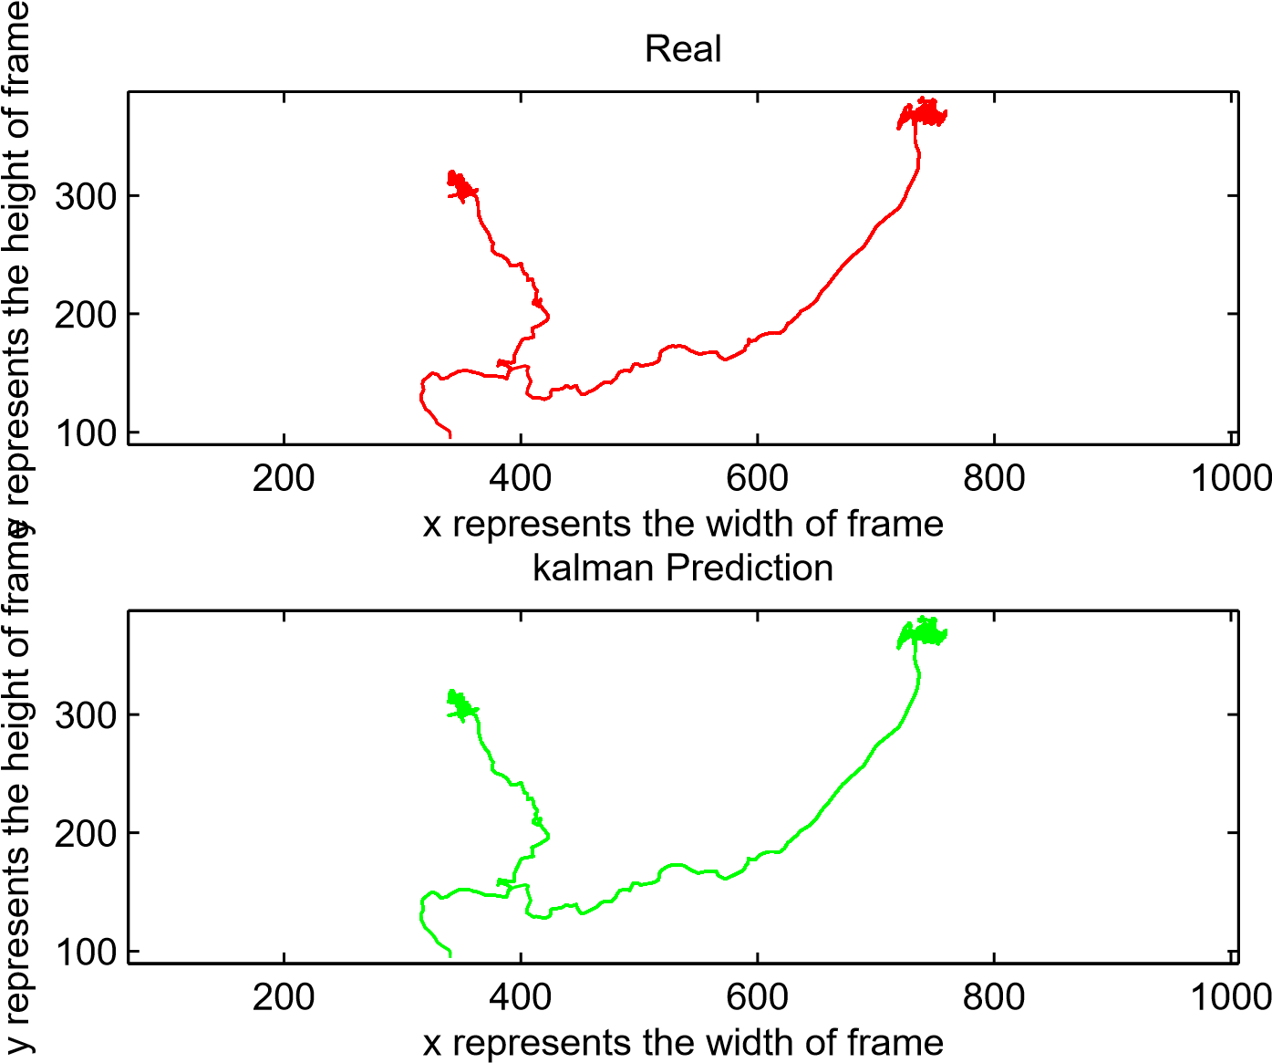
Objective Motion Path
Height of frame Height of frame
Width of Frame
Kalman Filter Prediction
Width of Frame

Slide 24
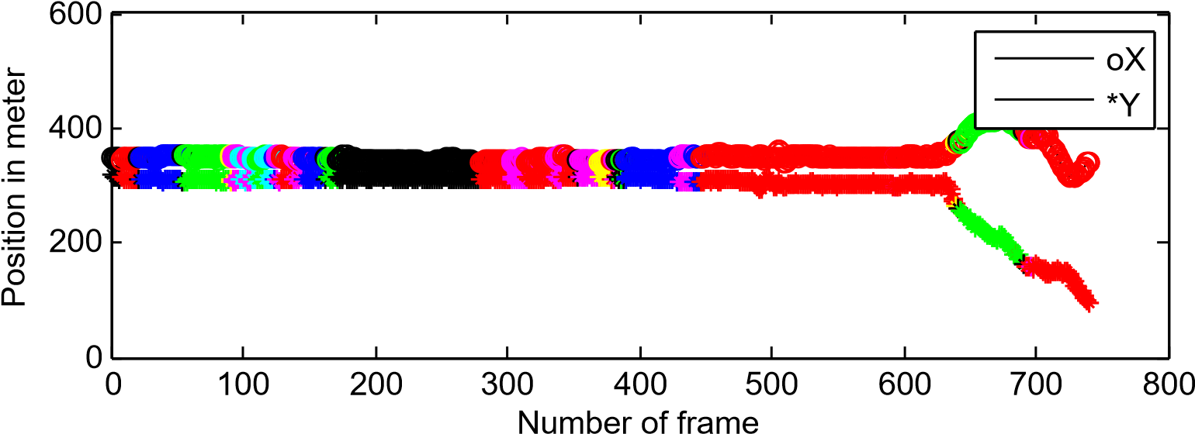
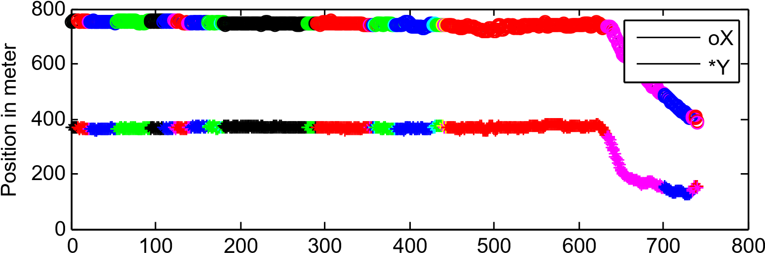
Position and Color of 78th Umbrella
Position in PX Position in PX
Number of Frame
Position and Color of 175th Umbrella
Number of Frame

Slide 25
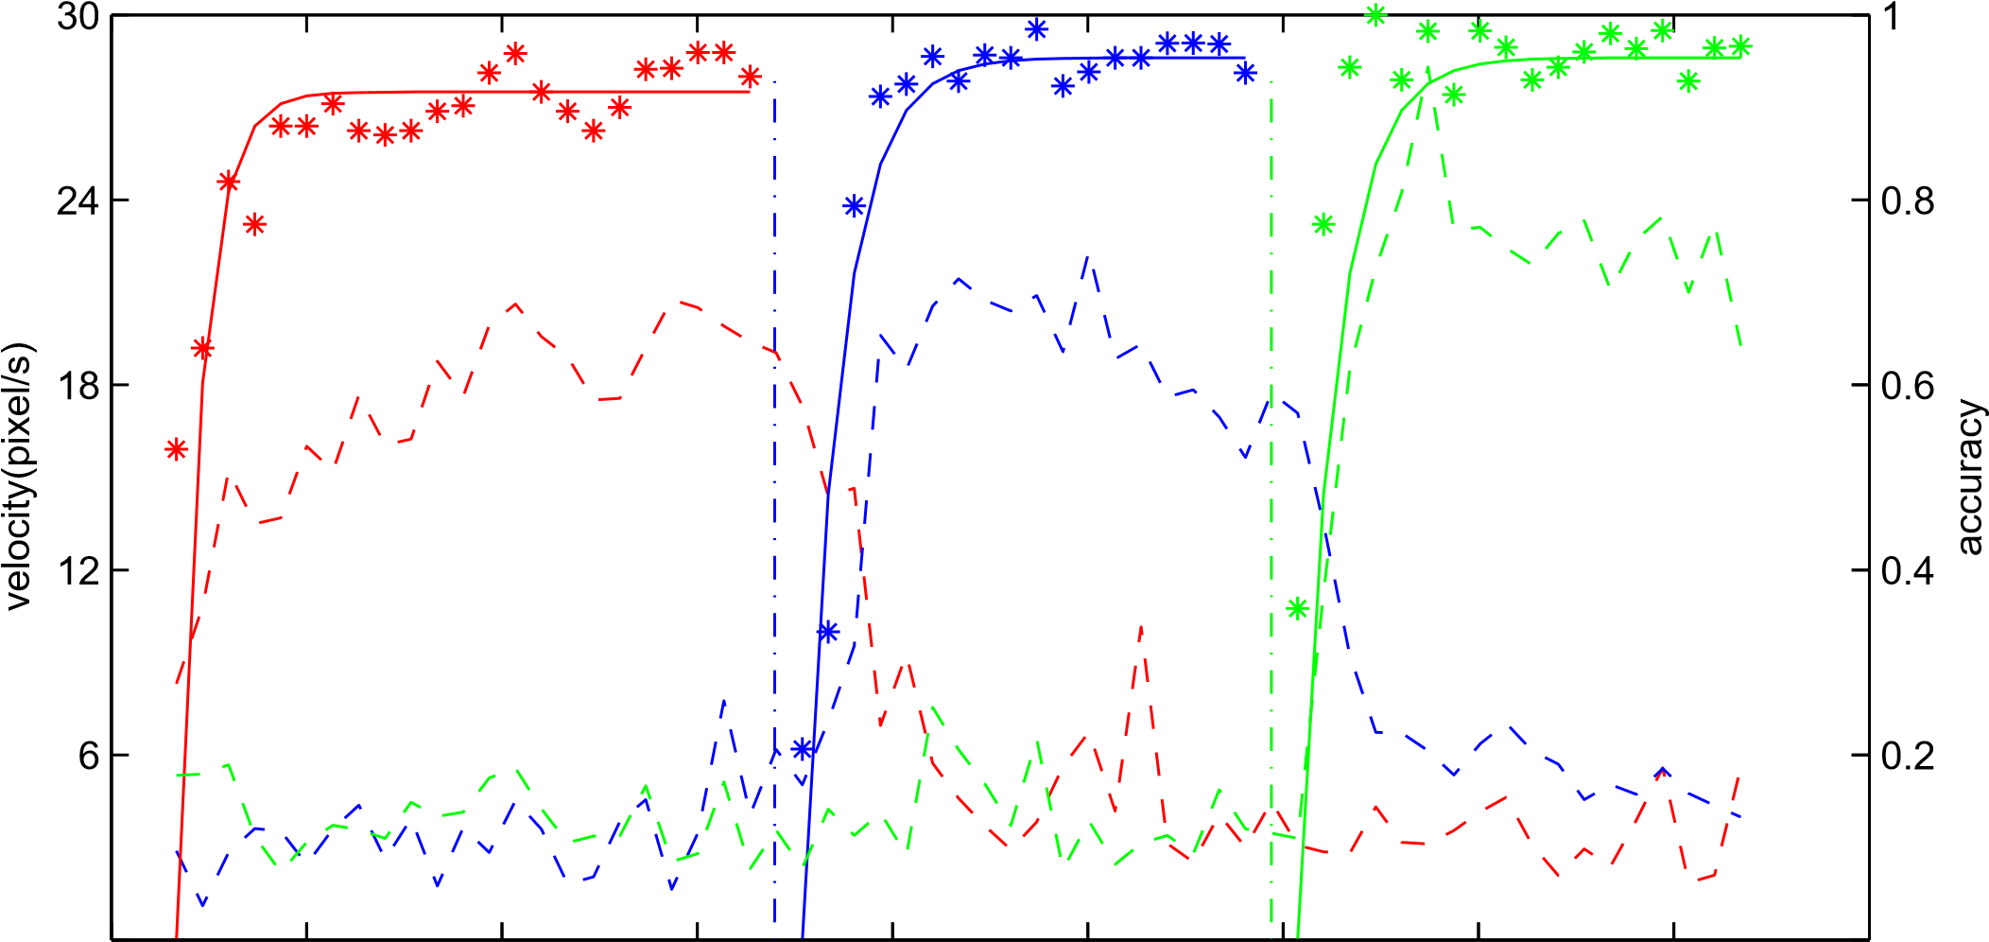
Velocity (pixel/s)
Accuracy
335 340 345 350 355 360 365 370 375 380
Time (s)

Slide 26
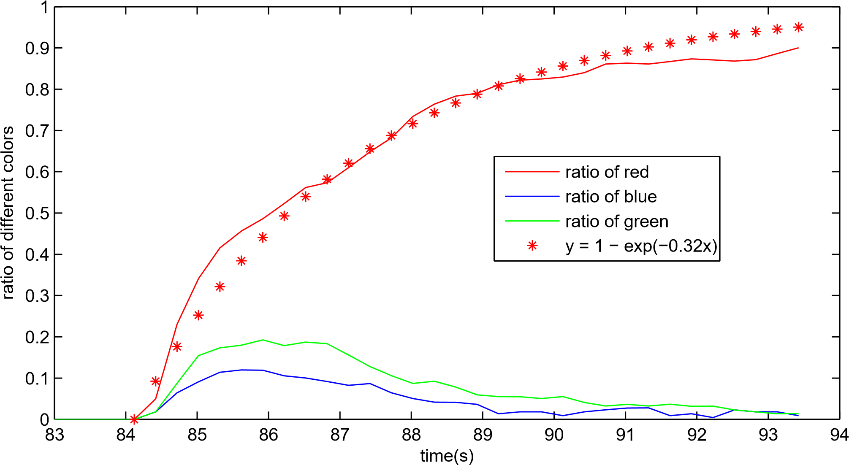
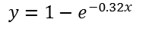
Ratio of different colors
$$y=1−e^{−0.32x}$$
Time (s)

Slide 27
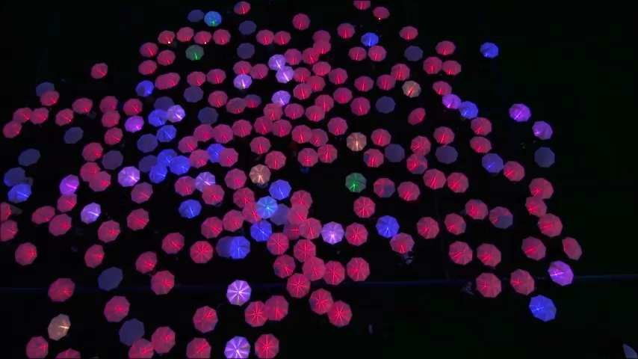
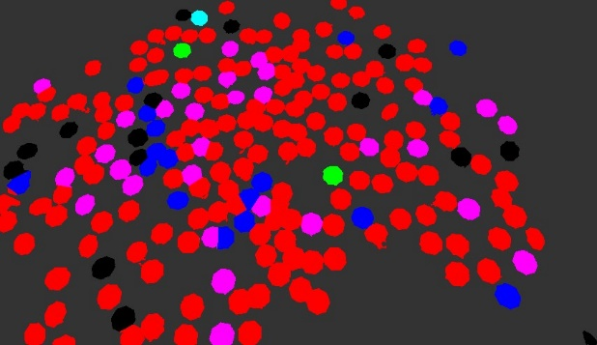
1)
2)
3)
400
Count of each color
200
0
0
200
400
600
800
1000
1200
1400
Frame 1390

Slide 28
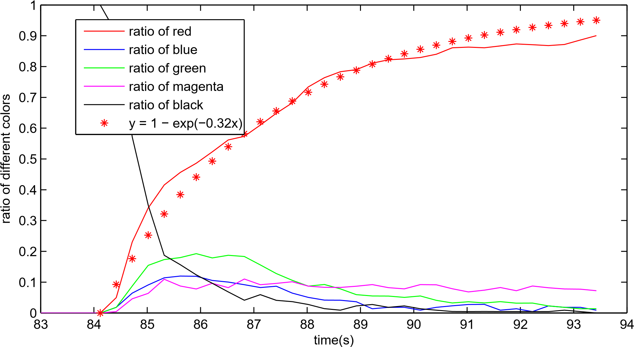
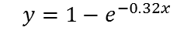
$$y=1−e^{−0.32x}$$
Ratio of different colors
Time (s)

Slide 29
Bullseye:
look up circlefit in matlab centool
1. how round are the circles?
2. what is the center of each circle
Give out the formula used for all plot

